Slide 1

Predicting Adult Autism Screening Outcomes Using Logistic Regression
1
A Data-Driven Approach to Preliminary ASD Screening
Baldwin, Jamie STAT 6302
ENTER
Notes:
Good Morning, my name is of course Jamie, and my project focuses on Predicting Adult Autism Screening Outcomes Using Logistic Regression.

Slide 2



01.
INTRODUCTION
2
01
02
03
04
Why Use Data for Autism Screening?
Notes:
Our first stop today is why should we even use data for autism screening?

Slide 3
Why This Matters (Background + Context)
3
Autism Diagnoses are often delayed
Early identification can improve access to support and accommodations
Screening tools like the Autism Spectrum Quotient (AQ-10) offer a quick alternative
Characteristics Present Waitlist Long Assessment Delayed Diagnosis
Vs
Quick Screen Flagged for Evaluation Earlier Support and Accommodations
Goal: Can we build a model that flags individuals who may need further evaluation?
01
02
03
04
Notes:
To understand why this is an area of focus, first some background information is needed. Autism isn’t always caught in early childhood; unfortunately, sometimes autistic individuals fall through the cracks and live most if not all their adolescents without access to support or accommodations that they might need.
To which the individual might seek out assessments and diagnosis in adulthood. Where they learn how time consuming and expensive it can be. With waitlists being a minimum of 5 to 6 months, assessments taking up to 5 hours (split up of course), and average costs being between $1,500 to $3,000 dollars out of pocket.
The goal of this project and why using data can be impactful is to help make the screening process more fluid for both patients and clinicians.

Slide 4
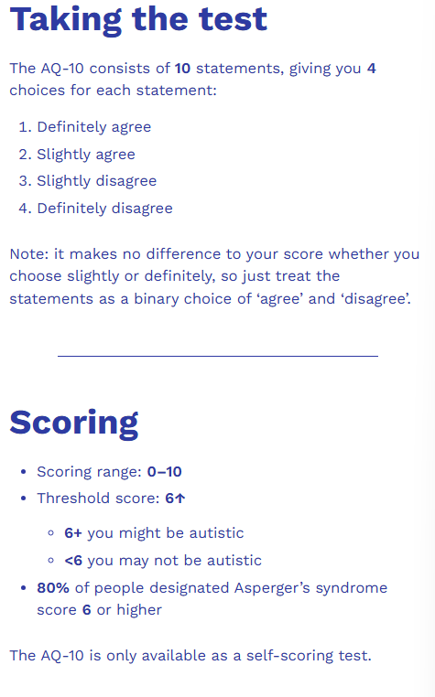
How Does the AQ-10 Work?
4
01
02
03
04
(Embrace Autism)
(Embrace Autism)
Notes:
The Autism Spectrum Quotient – 10 or AQ-10 for short is the survey that was used for the collection of this data, it is a shortened version of the original 50 item inventory. It has 10 questions hence the 10 in the name. Ranging from questions like “If there is an interruption, I can switch back to what I was doing very quickly,” to ,”I find it difficult to work out people’s intentions.” To which the respondent will agree or disagree on different levels to each question. Depending on if the respondent agrees or disagree determines if they score a 1 or 0. The pattern does change so feel free to reach out to me after if you’re interested to learn more. The threshold for the respondent to potentially be autistic is a score of 6 or higher, with about 80% of autistic individuals scoring a said 6 or higher.

Slide 5
02.
MODELING APPROACH
5
01
02
03
04
How were the models built?

Slide 6
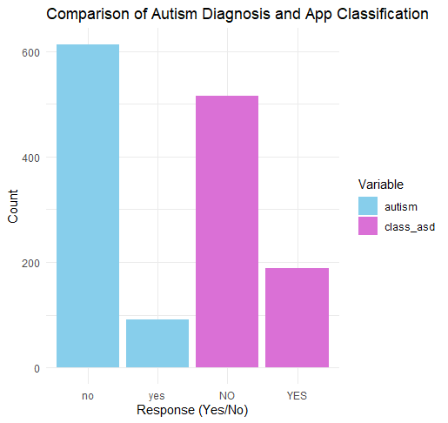
What’s the Dataset
6
Dataset Name: Autistic Spectrum Disorder Screening Data for Adults
704 Observations with 21 Variables
A mix of numerical, binary, and categorical
01
02
10 AQ-10 Survey Items -> Scored 0 or 1
Outcome: Diagnosed w/ ASD (Yes/No)
Also includes: age, gender, jaundice at birth, ethnicity, country of residence, sum of score, etc.
With some missing values and mistyped values
03
04
Notes:
Before we dive into modeling we should discuss the data. The dataset used for this project is essentially microscopic when compared to what we want to work with. With only 704 entries and 21 starting variables, extensive EDA was performed. After exploring each variable it was determined that we were to keep a total of 18 variables for modeling due to either no variance, strong multicollinearity, or it not being helpful to the models. The pictured graph is comparing the classification given by the AQ-10 and true diagnosis results of the subjects. We can see that there are similar proportions, it depicts what is already known that surveys are not perfect and not meant to diagnose but this shows promise in catching adults whom should be evaluated. Imputation and data correction did occur before any modeling was done. Up-sampling was later performed in some models due to the class imbalance.

Slide 7
7
Base Model
Elastic Net Model
Standard logistic regression with all predictors
No pre-proccessing besides dummy encoding
Adds regularization
Handles class imbalance via up-sampling
01
02
03
Custom Model 2
Custom Model 1
04
Adds two interaction terms:
Ethnicity x Screen Results
Gender x Jaundice
Handles class imbalance via up-sampling
Adds elastic net regularization
Notes:
Four models were built, the base model used standard logistic regression with dummy encoding. The Elastic Net model adds upon the base model by adding regularization and the use of up-sampling. Custom Model 1 adds upon the base model by adding 2 interaction terms and with up-sampling. Finally, Custom Model 2 adds upon CM1 by adding elastic net regularization.
All models applied resampling with repeated 10-fold CV, with 5 repeats for generalizability and for evaluation all models used Accuracy, AUC, Sensitivity, Specificity, Kappa, and Brier score.

Slide 8
03.
MODEL RESULTS
8
01
02
03
04
Which Model Possess the most Potential?

Slide 9
Model Metrics
9
 | Accuracy | Brier | Kappa | AUC | Spec | Sens
BM | 0.846 | 0.124 | 0.116 | 0.620 | 0.951 | 0.139
ENM | 0.680 | 0.202 | 0.187 | 0.708 | 0.686 | 0.640
CM1 | 0.696 | 0.219 | 0.156 | 0.608 | 0.721 | 0.528
CM2 | 0.683 | 0.201 | 0.183 | 0.711 | 0.692 | 0.625
01
02
03
04
Notes:
This table displays our model metrics. At first we see our BM has an accuracy of nearly 85% but then we see that our sensitivity and specificity are heavily imbalanced indicating that while the model is good at identifying individuals with allistic it struggles to correctly classify autistic individuals. This is most likely due to the class imbalance and because we did no up-sampling in this model.
Moving on, we see that even though CM1 has the higher accuracy of the next 3 models it’s not as balanced in terms of its specificity and sensitivity as we would like. This leaves the ENM and CM2 having the most potential.

Slide 10
04.
CONCLUSION
10
01
02
03
04
What are some further considerations?

Slide 11
Conclusion, Limitations, & Further Considerations
11
Winning model: Custom Model 2
Why: Most of the model metrics for CM2 were better and the 2 strongest predictors being a survey question (Q4) and the interaction term of gender and jaundice.
Limitations: Small dataset, models don’t have ideal sensitivity/specificity, important variables are “self-reported”, issues with generalizability.
Suggestions: Bigger datasets, perhaps inclusion of additional surveys and survey data.
01
02
03
04
Notes:
The top competing models were the EN Model and CM2, even though the EN Model had a more balanced sensitivity and specificity the majority of the model metrics for CM2 were better. In addition to that the 2 strongest predictors for custom model 2 were a survey question and the interaction term of gender and neonatal jaundice. This makes it more significant than the Elastic Net Model because it indicates the model focuses on variables that have been researched to be statistically associated with autism rather than one of the two strongest predictors being demographic data (country of residence, Sweden) for the Elastic Net Model, which doesn’t have nearly as much research behind to support this variable being more important.
Limitations include the data set being so small and thus there may be issues with the up-sampling potentially causing over-fitting, the most important variables are “self-reported” and thus perchance biased. Overall, more research and data collection on autism needs to occur to create a more accurate and generalizable model.
An obvious suggestion is the gain a bigger dataset but another idea may be to create a dataset that includes ad ditional professional screening survey data to be able to create a more expansive list of variables to better capture potential autistic traits.

Slide 12
THANKS!
12
01
02
03
Do you have any questions?
04
Notes:
Presentation Comments (Me):
add slide number; good design; good energy, eye contact, and volume - just move around the room more; how many continuous predictors, and did you try splines?; calibration/predicted probs?; on conclusion slide, rather than say CM2, remind the audience what that actually was;
Presentation Comments (Peer):
nice enegryi liked itI like how there was a clear structure to the entire presentation. She spoke clearly, the analysis made sense and was well-tailored to her data, especially EDA and adjusting to the smaller datasetMake the visuals easier to look at or read. everything else was greatVery interesting topic and good organize, and tried to communicated with audience It was a little fast speech but due to had limit of time it's understandable Adding custom models based on domain is meaningfulVisualization of ROC curves for models would've been helpfulVery well organized presentation, if I were to go back to these slides afterwards, I know I would easily be able to locate and remember where certain information is.Though it was very well organized, to me, the format and templete of the presentation was a little busy, but I do not think this is a huge problem.Great organization, and very clear speaking, told your story very well. Maybe add more visuals where you can but overall great job!The organization of the presentation is very good. The power point is very well designed, and the flow of the presentation is very good. I'm very impressive at how well she explained the topic because it seems like it is a very hard topic to get fully explained.I think I would like to keep the original name of the models because by the time she is going through the metrics, I already forget what custom model 2 stands for. Good job not reading off the slides too much.Could have mentioned some future possible analysis based on the limitations.Jamie was very well-rehearsed and clear in her presentation style. I also really love the theme of her slides.I don't think there were enough model performance plots included to provide a visual representation for the audience.Very nice slidesCould be more specific about the modeling methodsi really like the slide layout. kept me engaged very well. Hard to find a negative, but the slides do have lots of text, so maybe less clutter on the slides. Cute slides, nice flow. Great organization and was easy to follow. Love the topic.Might just be me but I lost track of how you come up with the custom model.. Would love to hear more on the decision processAlmost a 10/10. Slides were very easy to follow and organized. Presentation skills showed a very good mastery of the subject.The only critique was I would have liked to see more plots.The presentation was very well organized and the presenter spoke clearly.The visuals, while mostly clear, could have been more professional.Very good, knowledge on the topic, visually very good, very good on time. Definitely nervous, but recovered well. Could have more plots. The presentation was really good and really easy to follow. It had good visuals and flowed wellInclude some more variable importance and interpretation maybe? it was a good presentationLove the visuals. Simple and easy to follow. Maybe talked about why upsampling was done and not downsampling or smote? but i can understand that she might have had to cut somethings for time.Spoke really well, and at a good pace in order to understand what was being saidIt would be interesting to see more about the additional models createdThe presentation was visually appealing and colorful.More information on how they collected the data could be useful.

